Slide 1

ENGINEERING CHEMISTRY
Asha A
Department of Science and Humanities

Slide 2

ENGINEERING CHEMISTRY
Module 5- Energy storage devices - Batteries
Class content:
Battery Characteristics(contd.)
Capacity
Energy storage density
Cycle life
Energy efficiency
Shelf life
Tolerance to service conditions
Power density
Energy density

Slide 3

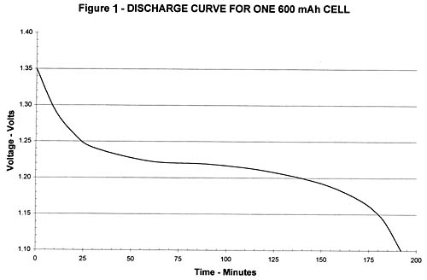
ENGINEERING CHEMISTRY
Module 5- Energy Storage devices- Batteries
Capacity:
Charge or amount of electricity that may be obtained from the battery
and is given in Ah
Faraday’s relation
C is the capacity , w is the mass and M is the molar mass of active material
Capacity depends on : Size of the battery
Discharge conditions of the battery
C = I t
The time period, t, for which the battery will last when a constant current, I, is drawn
Longer the flat portion of the curve better is the capacity
http://www.hangtimes.com/robert_hoff_on_esv_s.html

Slide 4
ENGINEERING CHEMISTRY
Module 5- Energy Storage devices- Batteries
Electricity Storage density:
Amount of charge or electricity per unit weight which the battery can hold
Weight includes weight of all the components of the battery - electrodes, electrolyte, case, current collectors, terminals etc
To get high electricity storage density, use of right kind of material for all the components is important
e.g., 7g of Li is required at anode to give 1F of charge whereas 104g of Pb is required for the same amount of charge

Slide 5
ENGINEERING CHEMISTRY
Module 5- Energy Storage devices- Batteries
Cycle life :
Number of charge/discharge cycles that are possible before failure occurs
Applicable only to secondary batteries
Reasons for limited cycle life:
Corrosion at contact points
Shedding of active material from the plates
Shorting between electrodes due to irregular crystal
growth and changes in morphology

Slide 6
ENGINEERING CHEMISTRY
Module 5- Energy Storage devices- Batteries
Energy efficiency:
Depends on efficiency of electrode reactions
Shelf life:
Maximum time for which a battery can be stored without
loss of performance
Low shelf life due to self-discharge
Tolerance to service conditions:
The battery has to be tolerant to different service conditions such as variation in temperature, vibration and shock

Slide 7


ENGINEERING CHEMISTRY
Module 5- Energy Storage devices- Batteries
Energy density:
where W is mass of the battery, i and E_{cell} are
current and EMF and t is time
watt-hr/kg

Slide 8


ENGINEERING CHEMISTRY
Module 5- Energy Storage devices- Batteries
Power density:
where W is mass of the battery, i and E_{cell} are current
and EMF
watt/kg

Slide 9
THANK YOU
Asha A
Department of Science and Humanities

